Slide 1




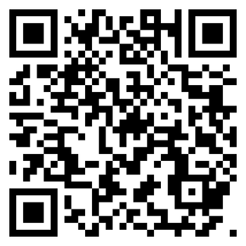





SURREY & SUSSEX CARERS
LOOKING AFTER SOMEONE THIS WINTER?
Do you help to look after someone because of illness, frailty, disability, a mental health problem, or an addiction?​​
DON’T FORGET YOUR OWN HEALTH.​
ASK A MEMBER OF OUR TEAM​
or scan the QR code to find out how we can help

Slide 2

SURREY & SUSSEX CARERS
LOOKING AFTER SOMEONE THIS WINTER?
Are you helping to look after someone because of illness, frailty, disability, a mental health​ problem, or an addiction?​
ASK A MEMBER OF OUR TEAM​
YOU MAY BE AN UNPAID CARER
or scan the QR code to find out how we can help
SUPPORT IS AVAILABLE

Slide 3

SURREY & SUSSEX CARERS
CARERS NEED​ SUPPORT TOO​
Do you help to look after someone because of illness, frailty, disability, a mental health problem, or an addiction?​​
MANY CARERS PUT THEIR OWN HEALTH LAST.​
ASK A MEMBER OF OUR TEAM​
or scan the QR code to find out how we can help

